Slide 1
CHAPTER 3 Text Data

Slide 2
Bag-of-X
Turning Natural Text into Flat Vectors
But …
“Emma”, “ravens” and “hello”

Slide 3
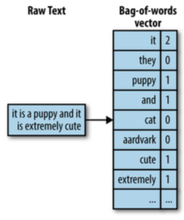
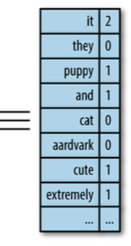
Bag-of-Words

Slide 4
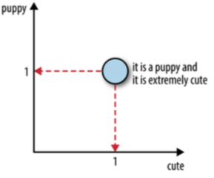
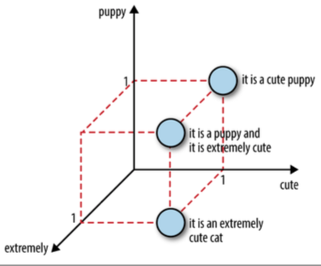
Sentences in nD feature space

Slide 5
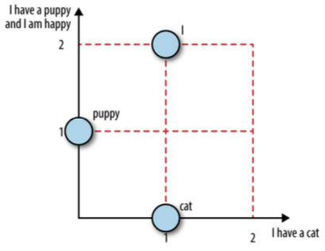
Word vectors in document space

Slide 6
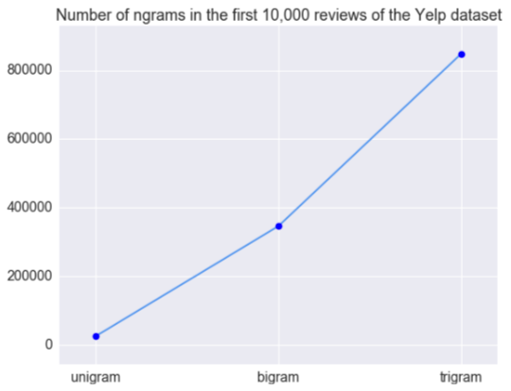
Bag-of-N-gram
After inputting “Emma knocked on the door” into bi-gram, what will happen?
Output: “Emma knocked”, “knocked on”, “on the”, “the door”….
More N or less N
More information or more efficiency?

Slide 7
Filtering for Cleaner Features
Stopwords
The pronouns, articles and prepositions
e.g. a, about, above , am, an, I’d, I’ll…
Frequency-Based Filtering
Frequent words
Rare words

Slide 8
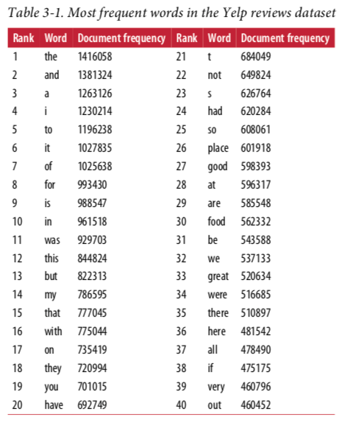
Frequency-Based Filtering
Frequent words
New York Times
In Yelp reviews dataset
Based on the number of documents they appear in,
not their count within a document.

Slide 9
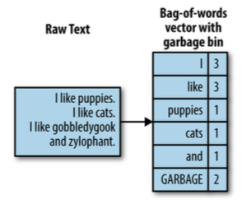
Frequency-Based Filtering
Rare words
View as noise (unreliable)
Generate computational overhead

Slide 10
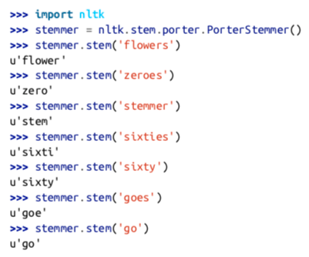
Stemming
The same stemming?
Flower and flowers
Swimmer, swimming and swim

Slide 11
Atoms of Meaning
How does one turn a string into a sequence of words?
Parsing
tokenization

Slide 12
Parsing and Tokenization
Different kinds of document, different parsing method
Web page: focus on URL, header, footer or other components
Email: some words such as ”subjects”, ”to” and “from”
Tokenization
Space characters are good separators

Slide 13
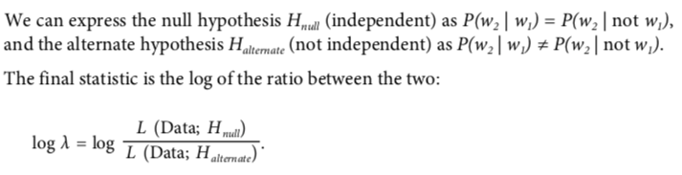
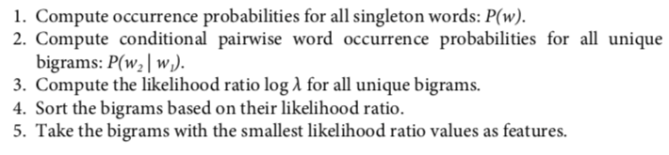
Collocation Extraction for Phrase Detection
What is collocation?
The concept of a useful phrase
How to…
Frequency-based methods: bi-gram
Hypothesis testing for collocation extraction
Chunking and part-of-speech tagging

